Slide 1


VIKAS GROUP OF INSTITUTIONS
AUTONOMOUS
DEPARTMENT OF
COMPUTER SCIENCE ENGINEERING

Slide 2
FACE RECOGNIZATION SYSTEM IN USING EDUSMART
BY:
P.OMSAI 249T5A0510
K.AVINASH 249T5AO506
K.SAI TEJA 249T5A0512

Slide 3
Contents :
Abstract
Introduction
Existing System
Proposed System
Requirements
Conclusion

Slide 4
Abstract:
A face recognition system is a biometric technology that identifies or verifies a person's identity by analyzing facial features from an image or video .

Slide 5
Introduction:
A facial recognition system is a technology that identifies or verifies a person's identity using their face. It works by analyzing facial features from a digital image or video and comparing them to a database of known faces .

Slide 6
Existing System:
Existing face recognition systems leverage a combination of image processing and machine learning techniques to identify or verify individuals from digital images or video. These systems typically involve capturing an image, extracting facial features, and comparing them against a database of known faces.

Slide 7
Proposed System:
Face detection.
Preprocessing.
Feature extraction and classification.

Slide 8
Requirements:
HTML 5
CSS
PYTHON
JAVA SCRIPT

Slide 9
Results:
The core result of a facial recognition system is the identification or verification of an individual based on their unique facial features .

Slide 10

FACE RFECOGNIZATION SYSTEM CODE:

Slide 11

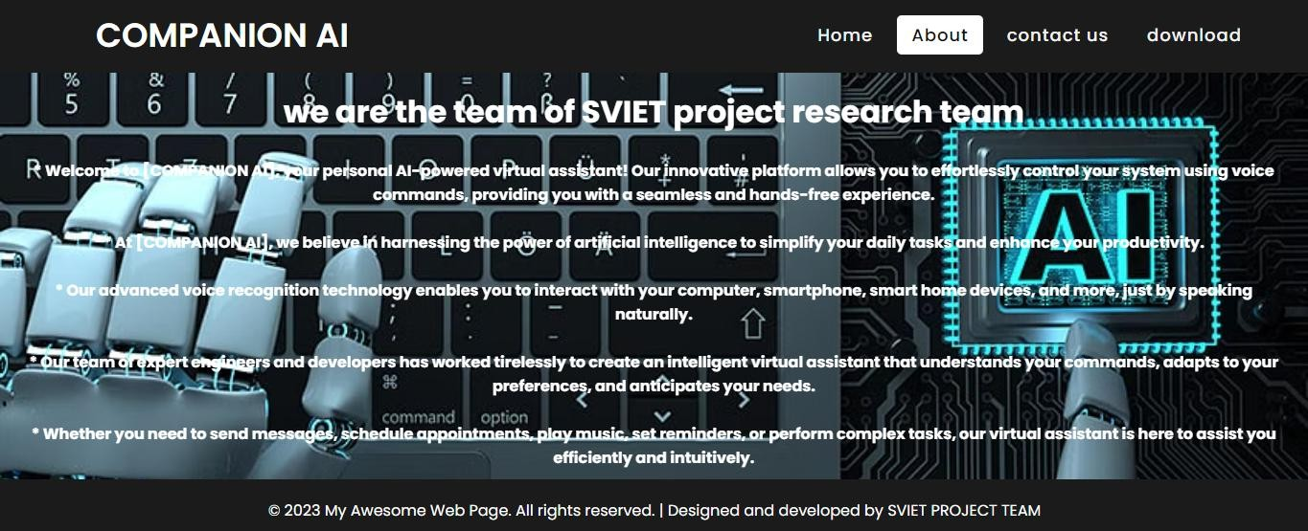
AI FACE RECOGNIZATION –DASHBOARD:

Slide 12

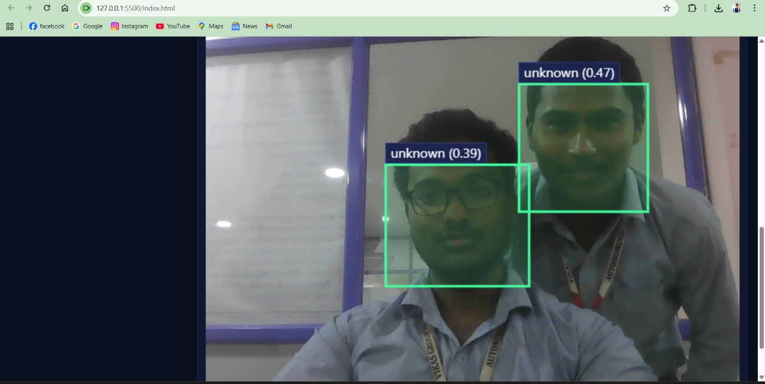
To Register the Student

Slide 13


Registered Students ID’S

Slide 14
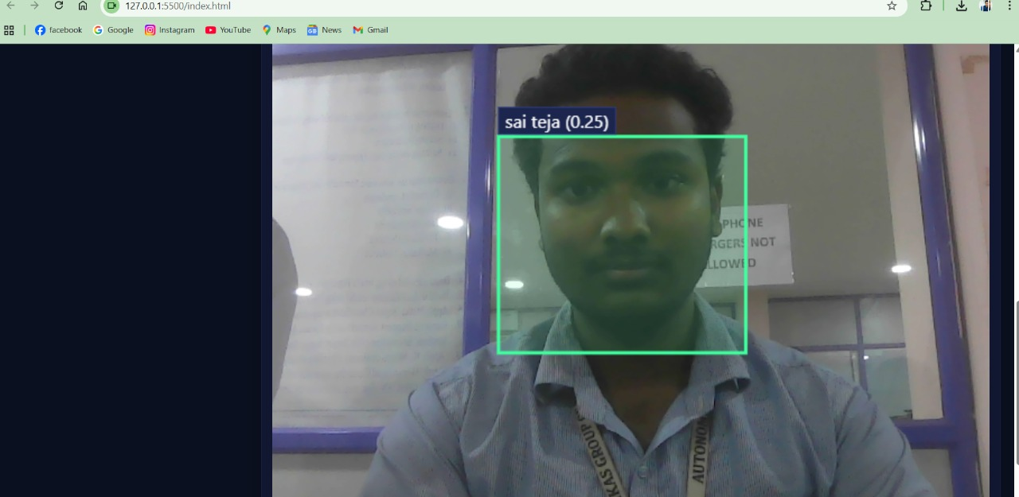

To Identify The Known Person

Slide 15
Conclusion:
Face recognition systems offer a fast and reliable method for identity verification, enhancing security and user convenience. However, challenges like accuracy under varying conditions and privacy concerns must be carefully managed.

